Slide 1
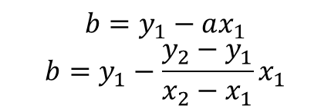

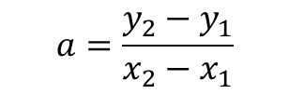
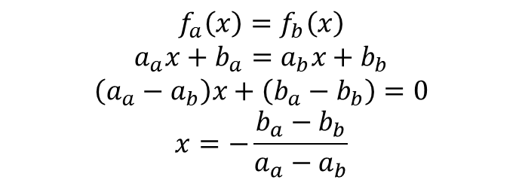






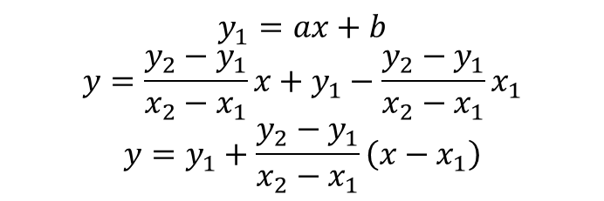
$$a=\frac{y_{2}−y_{1}}{x_{2}−x_{1}}$$
$$b=y_{1}−ax_{1}$$
$$b=y_{1}−\frac{y_{2}−y_{1}}{x_{2}−x_{1}}x_{1}$$
$$\left(x_{1},y_{1}\right)=({lng}_{1}, {lat}_{1})$$
$$\left(x_{2},y_{2}\right)=({lng}_{2}, {lat}_{2})$$
$$y_{1}=ax+b$$
$$y=\frac{y_{2}−y_{1}}{x_{2}−x_{1}}x+y_{1}−\frac{y_{2}−y_{1}}{x_{2}−x_{1}}x_{1}$$
$$y=y_{1}+\frac{y_{2}−y_{1}}{x_{2}−x_{1}}\left(x−x_{1}\right)$$
$$\left(x_{1},y_{1}\right)$$
$$\left(f_{x}\left(x\right),f_{y}\left(y\right)\right)$$
$$\left(x_{3},y_{3}\right)$$
$$\left(x_{4},y_{4}\right)$$
$$\left(x_{2},y_{2}\right)$$
$$f_{a}\left(x\right)=f_{b}\left(x\right)$$
$$a_{a}x+b_{a}=a_{b}x+b_{b}$$
$$\left(a_{a}−a_{b}\right)x+\left(b_{a}−b_{b}\right)=0$$
$$x=−\frac{b_{a}−b_{b}}{a_{a}−a_{b}}$$

Slide 2





$$\left(x_{1},y_{1}\right)=({lng}_{1}, {lat}_{1})$$
$$\left(x_{1},y_{1}\right)$$
$$\left(x_{2},y_{2}\right)$$
$$\left(x_{3},y_{3}\right)$$
$$\left(x_{4},y_{4}\right)$$

Slide 3
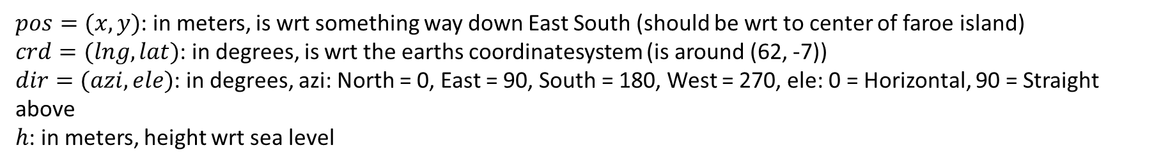
$pos=(x,y)$: in meters, is wrt something way down East South (should be wrt to center of faroe island)
$crd=(lng,lat)$: in degrees, is wrt the earths coordinatesystem (is around (62, -7))
$dir=(azi, ele)$: in degrees, azi: North = 0, East = 90, South = 180, West = 270, ele: 0 = Horizontal, 90 = Straight above
$h$: in meters, height wrt sea level
$$\left(x_{1},y_{1}\right)$$
$$\left(x_{2},y_{2}\right)$$
$$\left(x_{3},y_{3}\right)$$
$$\left(x_{4},y_{4}\right)$$

Slide 4
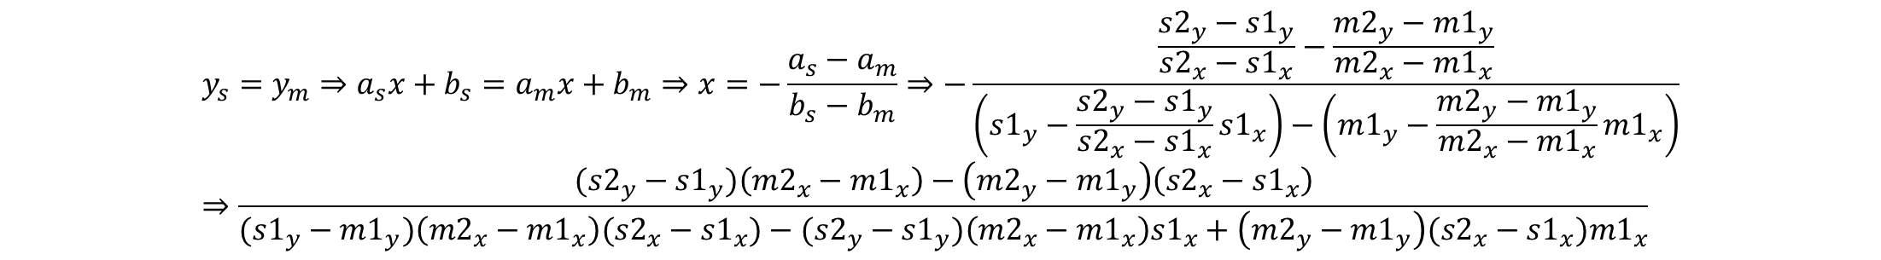
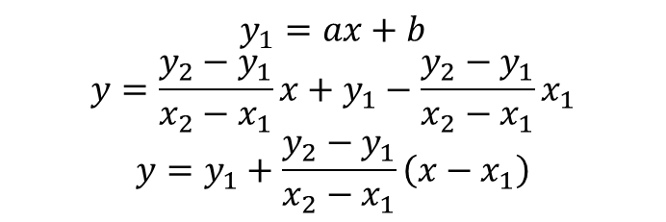
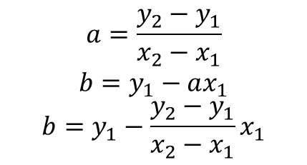
$$y_{1}=ax+b$$
$$y=\frac{y_{2}−y_{1}}{x_{2}−x_{1}}x+y_{1}−\frac{y_{2}−y_{1}}{x_{2}−x_{1}}x_{1}$$
$$y=y_{1}+\frac{y_{2}−y_{1}}{x_{2}−x_{1}}\left(x−x_{1}\right)$$
$$a=\frac{y_{2}−y_{1}}{x_{2}−x_{1}}$$
$$b=y_{1}−ax_{1}$$
$$b=y_{1}−\frac{y_{2}−y_{1}}{x_{2}−x_{1}}x_{1}$$
$$y_{s}=y_{m}⇒a_{s}x+b_{s}=a_{m}x+b_{m}⇒x=−\frac{a_{s}−a_{m}}{b_{s}−b_{m}}⇒−\frac{\frac{{s2}_{y}−{s1}_{y}}{{s2}_{x}−{s1}_{x}}−\frac{{m2}_{y}−{m1}_{y}}{{m2}_{x}−{m1}_{x}}}{\left({s1}_{y}−\frac{{s2}_{y}−{s1}_{y}}{{s2}_{x}−{s1}_{x}}{s1}_{x}\right)−\left({m1}_{y}−\frac{{m2}_{y}−{m1}_{y}}{{m2}_{x}−{m1}_{x}}{m1}_{x}\right)}⇒\frac{({s2}_{y}−{s1}_{y})\left({m2}_{x}−{m1}_{x}\right)−\left({m2}_{y}−{m1}_{y}\right)\left({s2}_{x}−{s1}_{x}\right)}{({s1}_{y}−{m1}_{y})\left({m2}_{x}−{m1}_{x}\right)({s2}_{x}−{s1}_{x})−({s2}_{y}−{s1}_{y})\left({m2}_{x}−{m1}_{x}\right){s1}_{x}+\left({m2}_{y}−{m1}_{y}\right)({s2}_{x}−{s1}_{x}){m1}_{x}}$$
$$\%_{s}=\frac{x−{s1}_{x}}{s2_{x}−s1_{x}}$$

